Slide 1
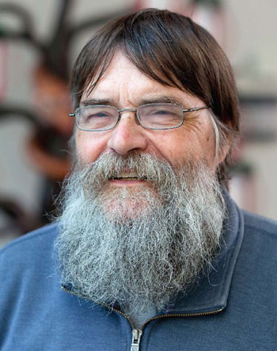
Peter Guttorp: Friend and Colleague through Many Adventures — inside and outside the walls of academia
or
Travels with Peter
or
Peter Guttorp: “Renaissance Man” / “Polymath”
Notes:
Trying to put together something about Peter for a meeting like this is a little difficult because everyone here knows Peter! But with the help of his CV, Facebook, and photos of my own, here we go.

Slide 2
Renaissance Man / Polymath
“Renaissance Man” or “Polymath” (from Wikipedia):
is a person whose expertise spans a significant number of different subject areas; such a person is known to draw on complex bodies of knowledge to solve specific problems.
Polymaths include the great thinkers of the Renaissance and the Enlightenment who excelled at several fields in science and the arts.
"Renaissance man" was first recorded in written English in the early 20th century.^{[4]} It is now used to refer to great thinkers living before, during, or after the Renaissance. Leonardo da Vinci has often been described as the archetype of the Renaissance man, a man of "unquenchable curiosity" and "feverishly inventive imagination".^{[5]}
Notes:
I’ll get to the Travels with Peter, but let me start with the “Renaissance Man” or “Polymath”. Now I’m not going to put Peter in the same class as Leonardo da Vinci. And, in fact, I know that many of you have expertise and interests in diverse fields, but I think that Peter’s are pretty compelling evidence for classifying him as a Renaissance Man or Polymath.

Slide 3
Areas of Peter’s interest and expertise:
Journalism
B. Journ., College of Journalism, Stockholm, Sweden, 1969.
Music
1972-74 Junior high school teacher in music and mathematics, Sweden
Sports
Too numerous to name, but see photos
Sciences
See the agenda for this workshop!
Statistics
See the agenda for this workshop!
Notes:
I have nothing really to document his background in journalism, but there is plenty of support for everything else here. One of our grad students recently reminded me of the John Tukey quote: “The best thing about being a statistician is that you get to play in everyone’s backyard.” Peter has spend a lot of his time in the backyards of environmental and biological scientists.

Slide 4
Academics:
Notes:
Yes, Peter went to school in Sweden and the US and got some awards (like Phi Beta Kappa)

Slide 5
Notes:
Just wanted to throw this photo from his formative years into the bunch.

Slide 6
A small subset of Peter’s Honors:
J. S. Hunter lecture, The International Environmetric Society.
Medallion lecturer, Joint Statistical Meeting, Montreal.
Chalmers Jubilee Professor
Constance Van Eeden lecturer, University of British Columbia.
Fellow of the Institute of Mathematical Statistics
Fellow of the American Statistical Association
Inaugural CANSSI visiting professor, UBC Okanagan.
Nobel Peace Prize (Intergovernmental Panel on Climate Change)
and …
Notes:
Now let’s present an obligatory, but abbreviated, review of academic highlights and honors. I wanted to make sure I included all his Canadian honors for this meeting.

Slide 7
Technologiae doctor honoris causa, Lund University.

Slide 8
Peter’s professional roles in service to Statistics, Science and Society, are way too numerous to summarize. I highlight a few, omitting almost all the associate editorships and the many scientific panels and program committees he has served on.
Member, Precipitation Committee, American Geophysical Union
Member, Panel on Spatial Statistics, National Research Council
Contributor, Intergovernmental Panel on Climate Change Second Assessment Report: Climate Change 1995
Reviewer, Intergovernmental Panel on Climate Change Third Assessment Report: Climate Change 2001.
Technical director, Nordic Network on Statistical Approaches to Regional Climate Models for Adaptation
President, The International Environmetric Society
Director, National Research Center for Statistics and the Environment (NRCSE)
Co-editor Environmetrics
Member, American Statistical Association Cuba delegation

Slide 9
With Congressman Jim McDermott (2012?)
Notes:
I listed all the above mainly as an excuse to show this photo as a testament to Peter’s efforts to impact actual policy.
Now on to some non-academic interests and shared experiences, or Travels with Peter.

Slide 10
Music
Notes:
Now on to other interests. Peter’s family, and in particular his father, had a big influence in his musical background. I noted that he taught junior high school music. Here he is performing.

Slide 11
Sports in our early years in Seattle

Slide 12
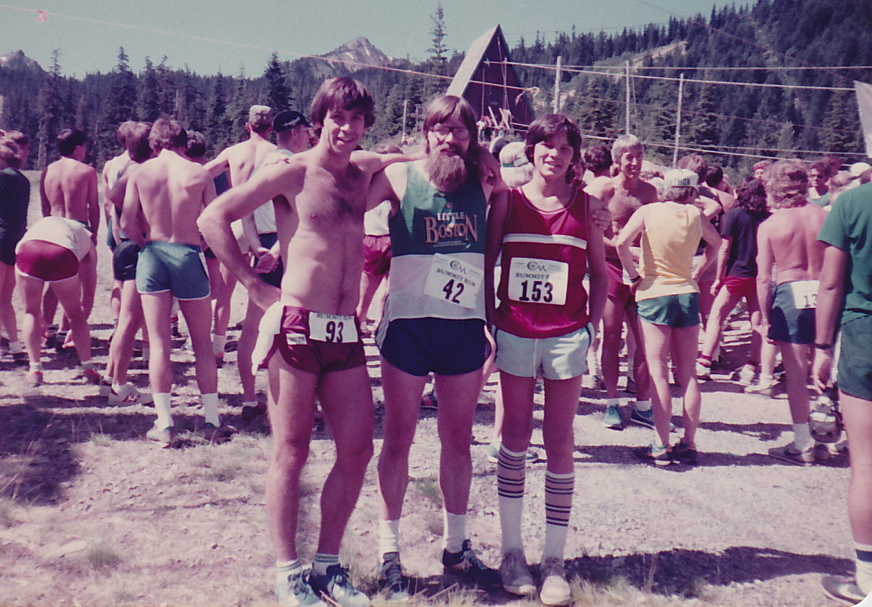
Crystal Mt Summit Run -- 1982

Slide 13
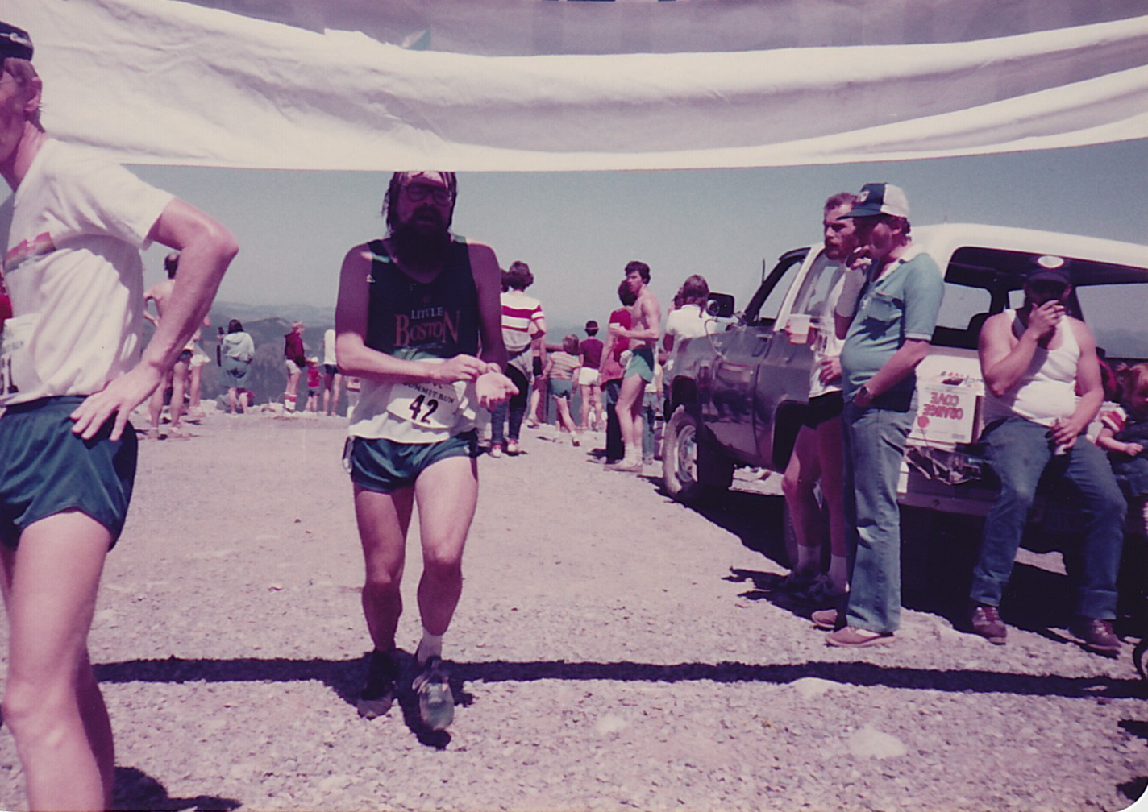
--- 4 miles and 2,500 vertical feet later!

Slide 14
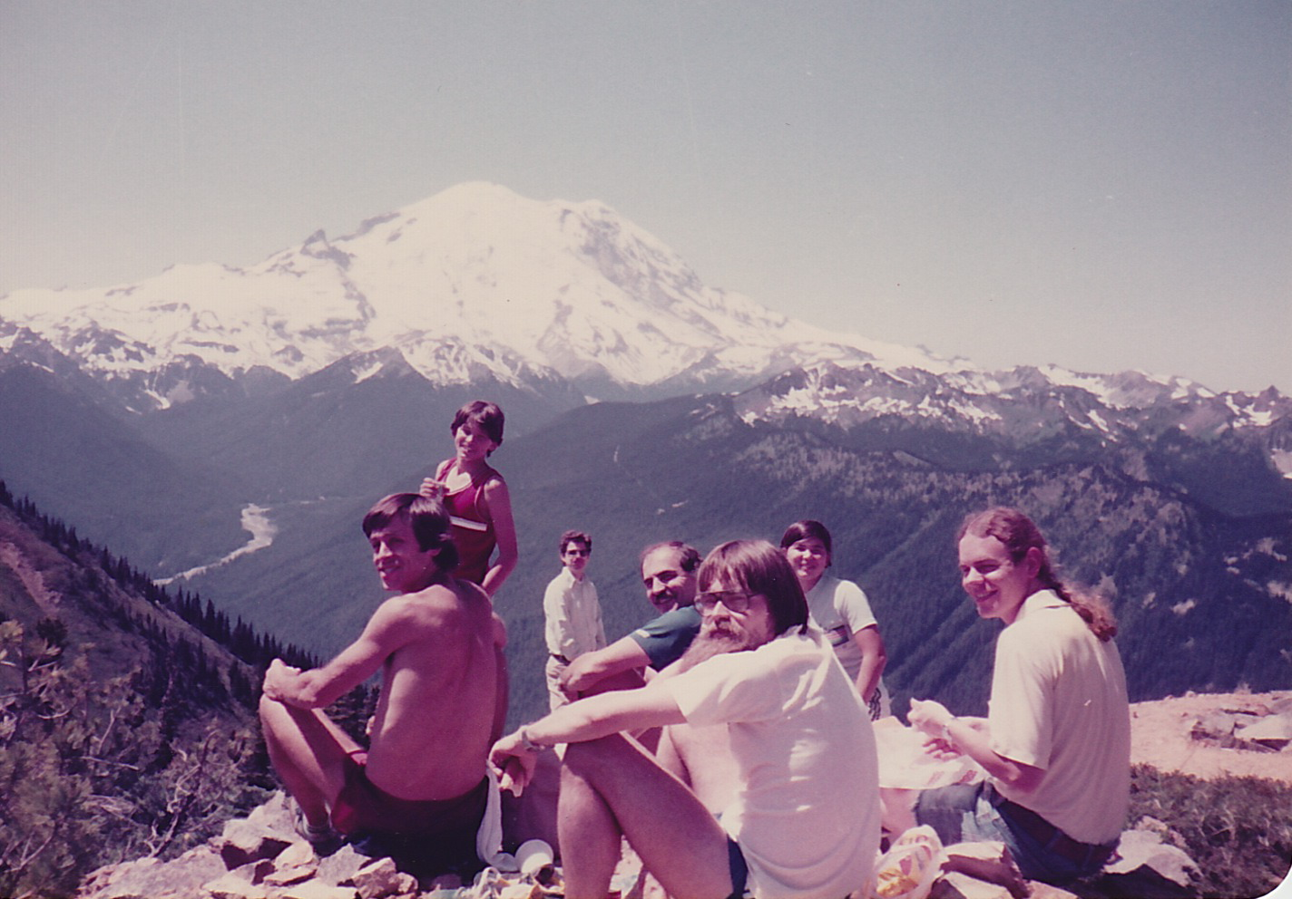

Slide 15
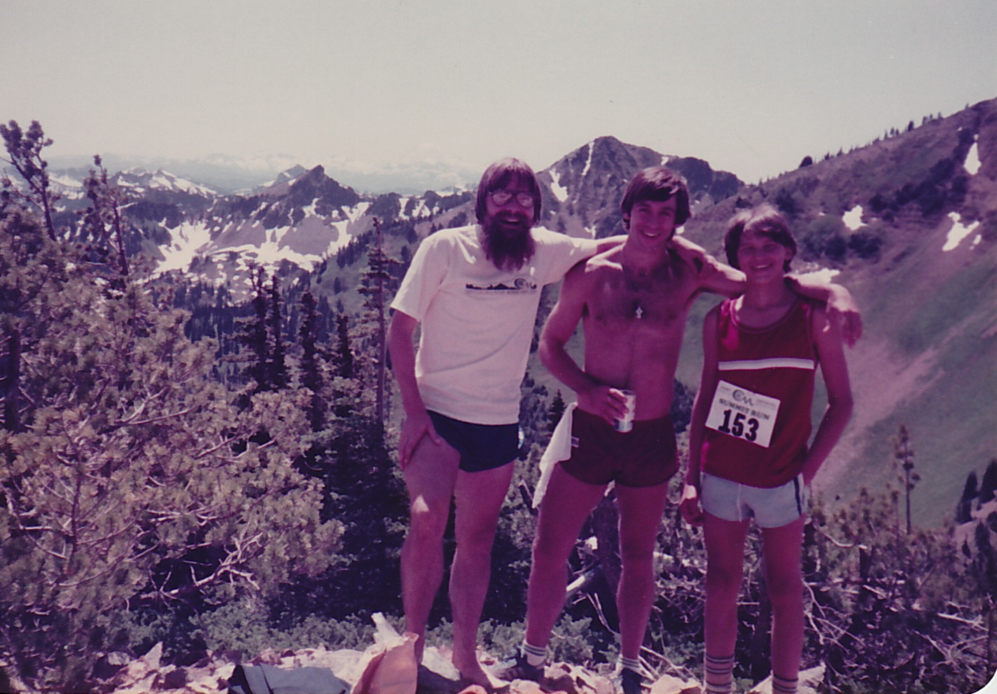

Slide 16
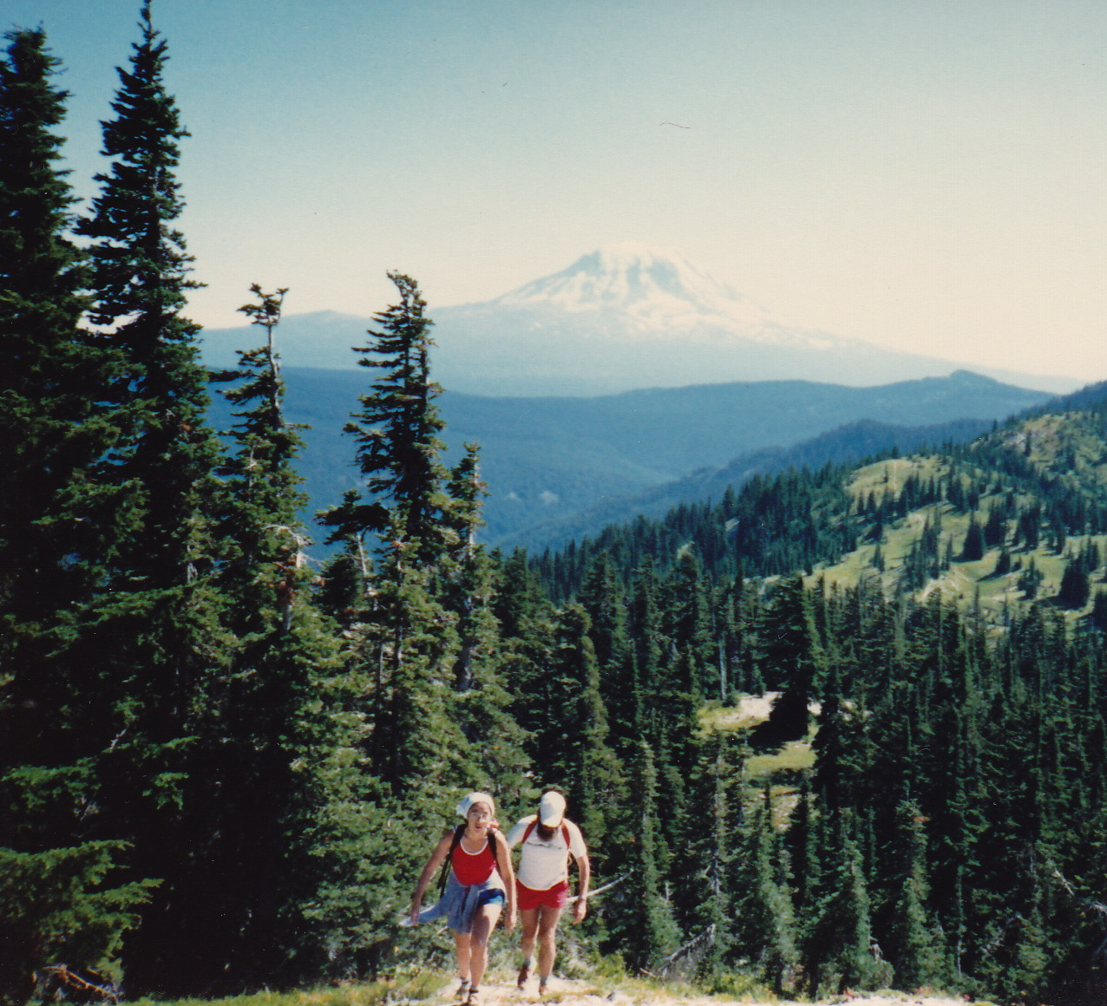
Hiking w/ Peter & June

Slide 17
Soccer!
Notes:
Peter (and June) and I share a passion for soccer.

Slide 18
Players from Sweden, Norway, Brazil, Canada, USA, Palestine/Lebanon, India, New Zealand, Mexico, Saudi Arabia, at least

Slide 19
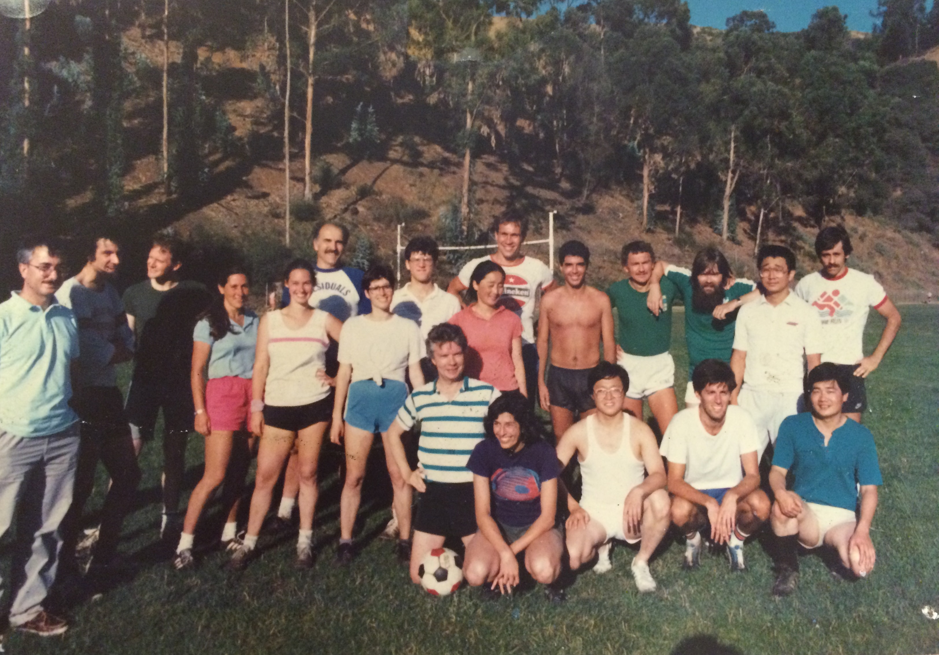

Slide 20
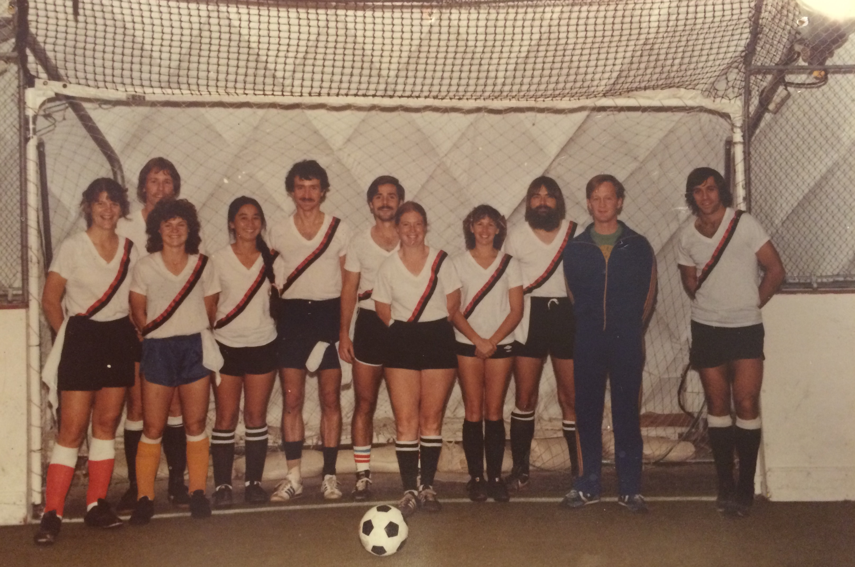
The Slugs of Mystery!

Slide 21
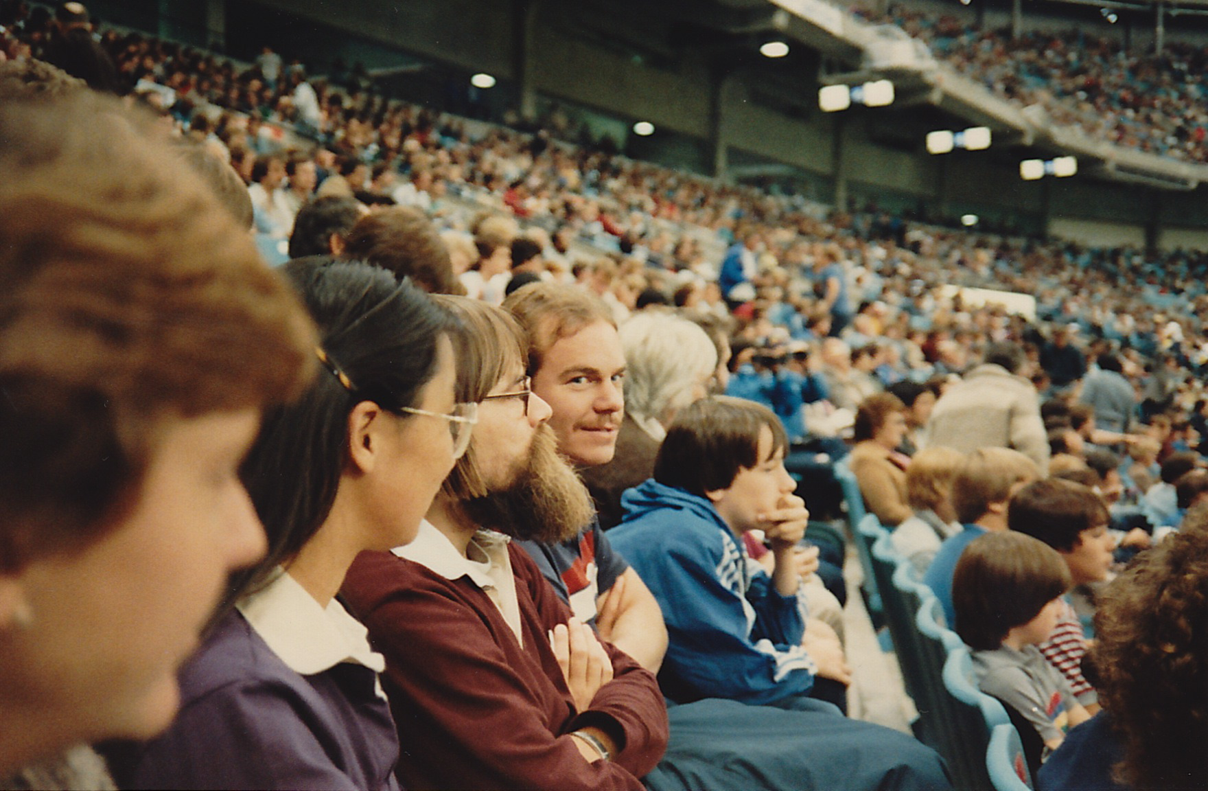
Watching the NASL Sounders at the Kingdome

Slide 22
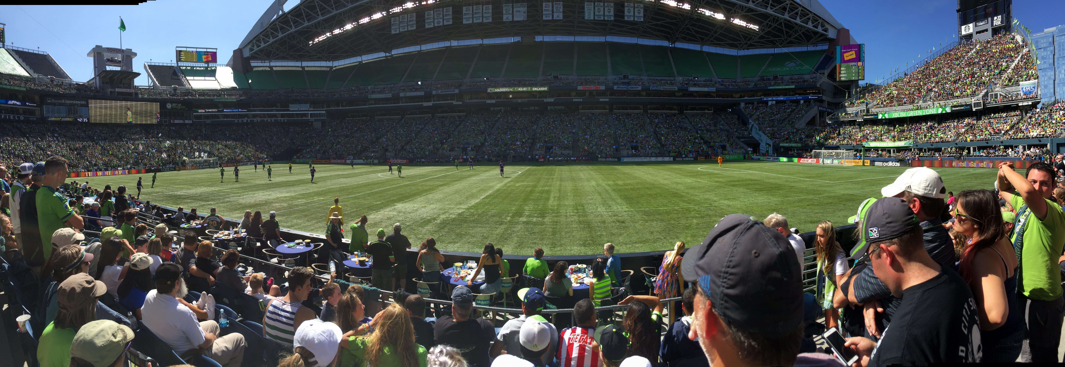
Watching the Sounders at the “Xbox Pitch”, Aug 2015

Slide 23
My travels with Peter.
2001 Portland, Oregon TIES
2003 Johannesburg, South Africa TIES
2004 Portland, Maine TIES
2008 Kelowna, BC, Canada TIES
2009 Bologna, Italy TIES
Isla de Margarita, Venezuela TIES
2011 Reykjavik, Iceland SARMA/TIES Workshop on Visualization of Climate Data
2011 Dublin, Ireland ISI
2014 Buzios, Brazil Pan American Advanced Study Institute
Notes:
Peter is enormously well-traveled. These are most of the trips that I have made with Peter. And the important point is that Peter played a large role in the organization and selection of the locations for many of these meetings. Photos are from the italicized meetings: Italy, Venezuela, Iceland, and Brazil.

Slide 24
July 2009, Bologna

Slide 26
Academics entertained at Isla de Margarita, Venezuela

Slide 29
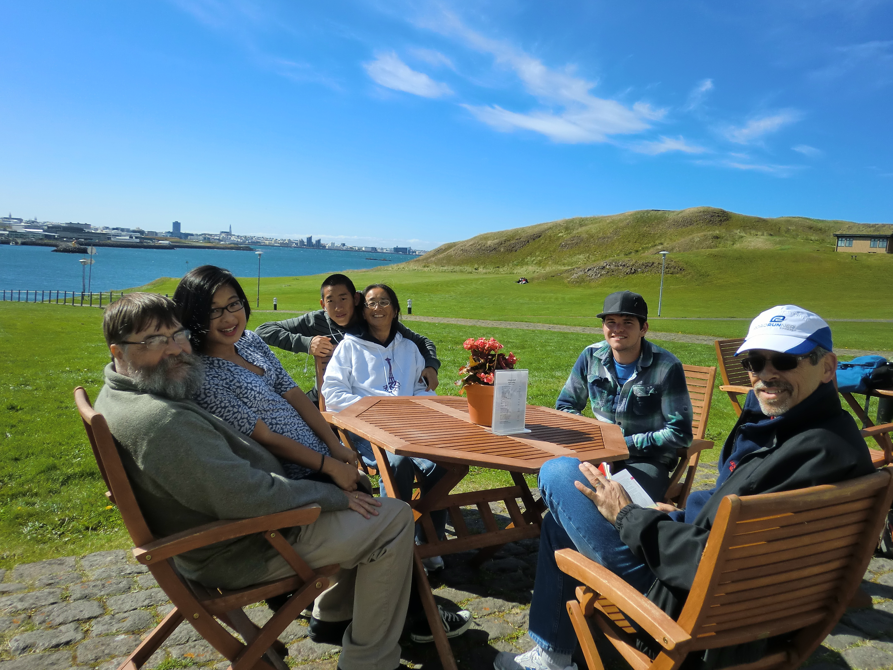
Iceland

Slide 30
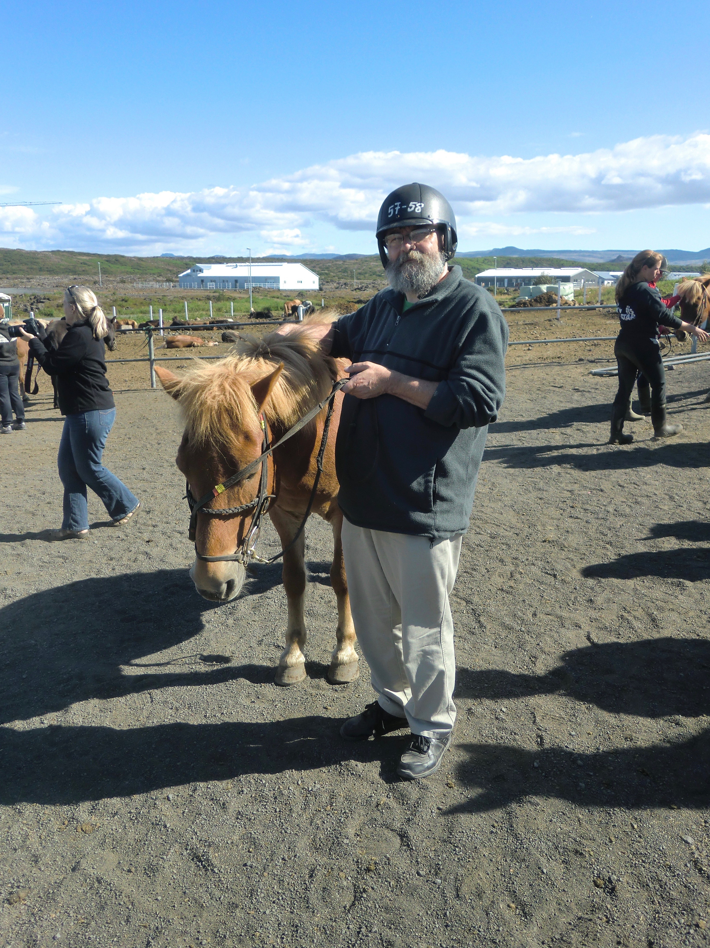

Slide 31
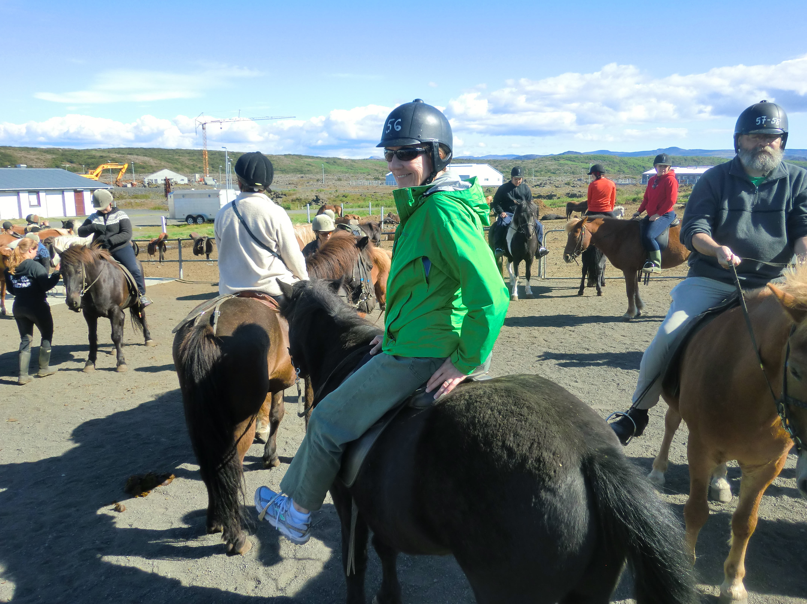

Slide 32
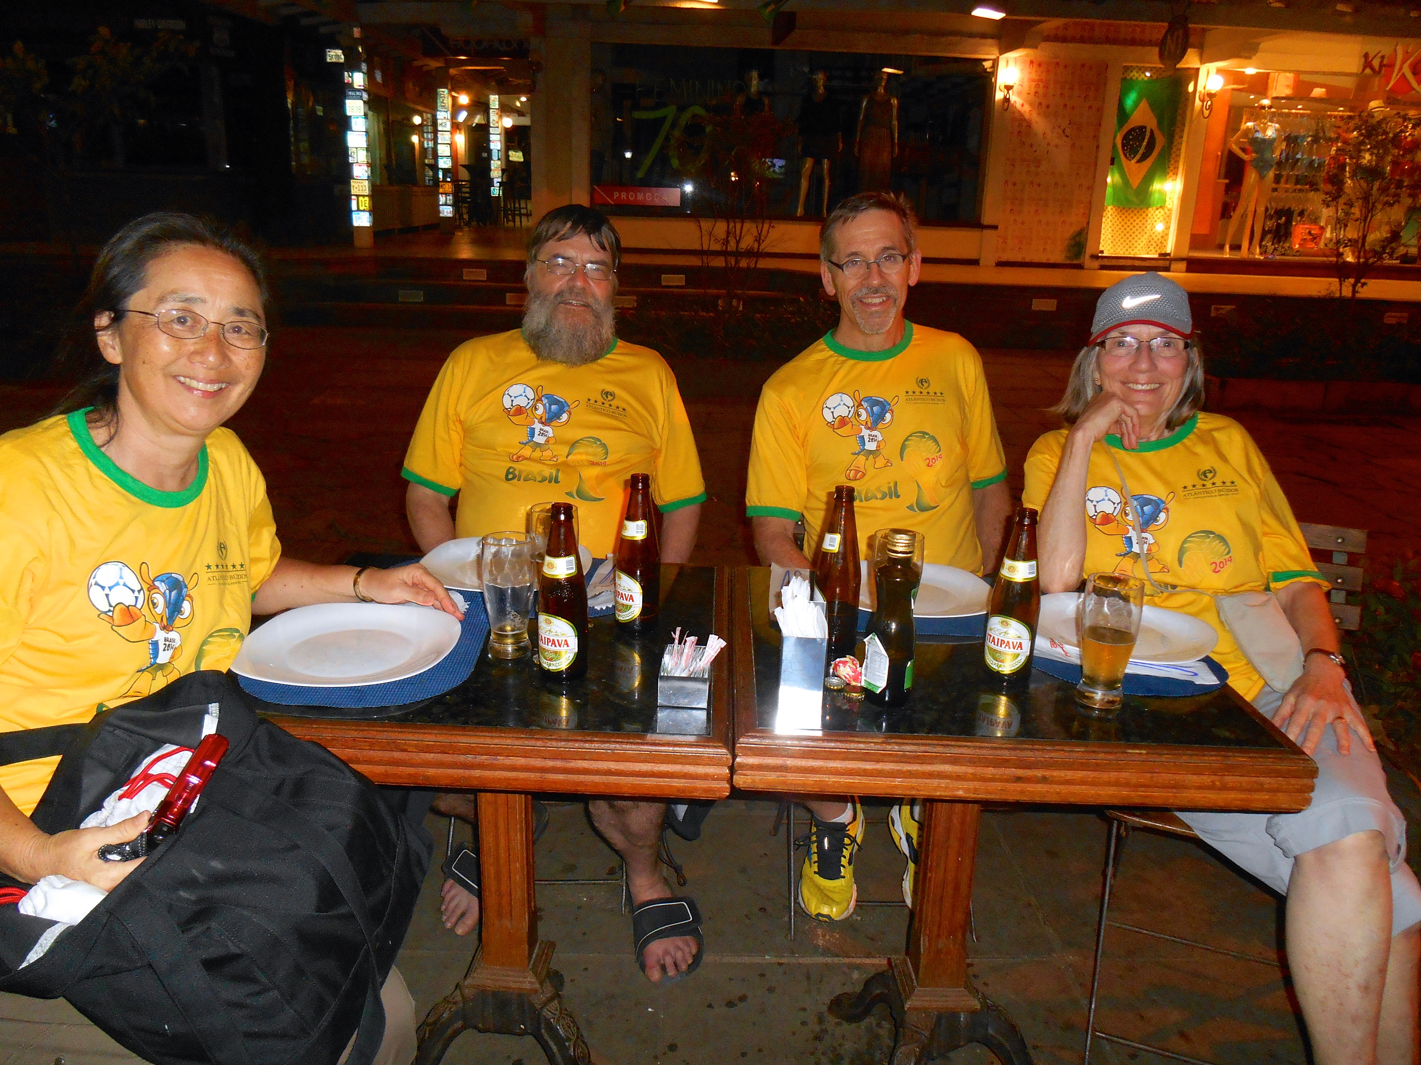
Brazil

Slide 33
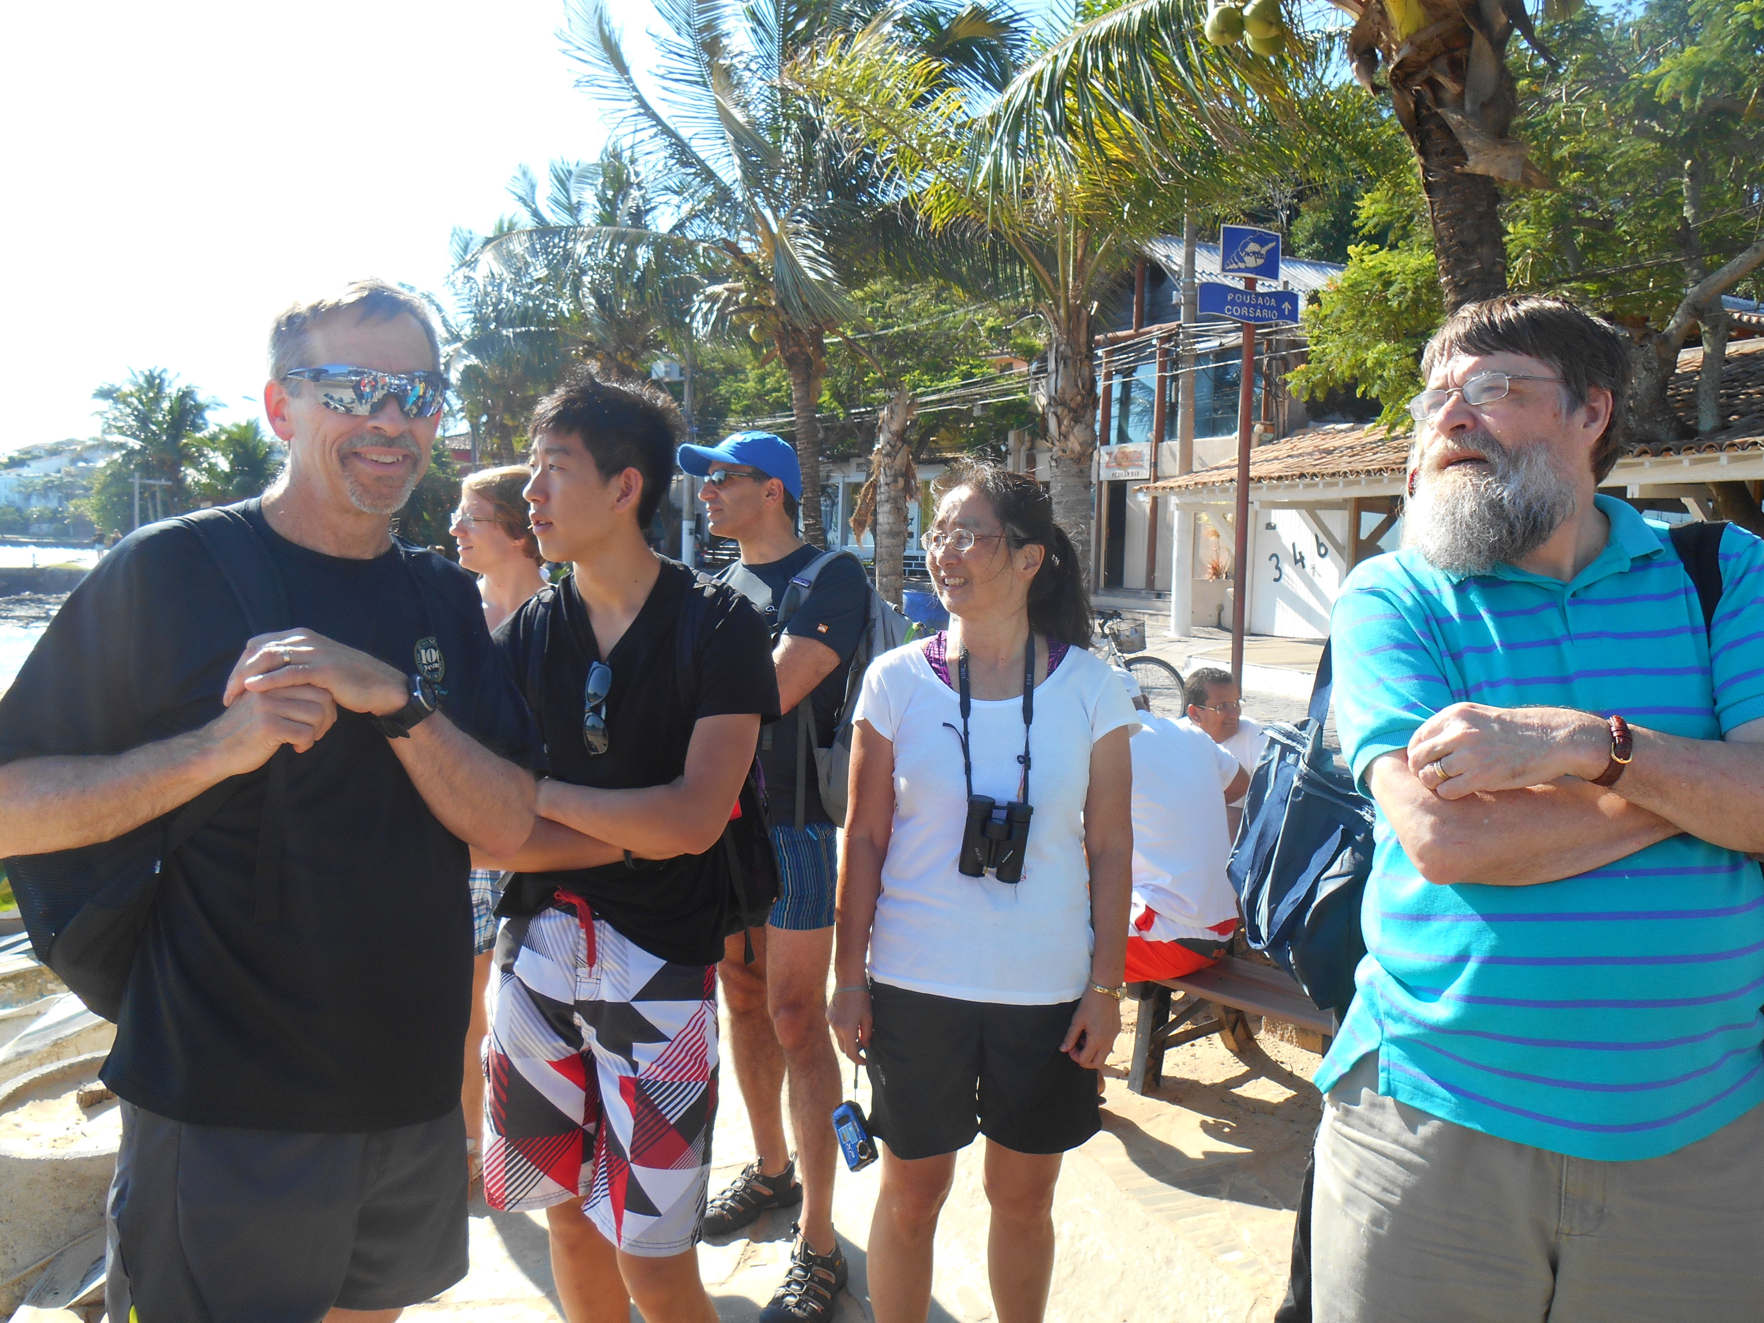

Slide 34
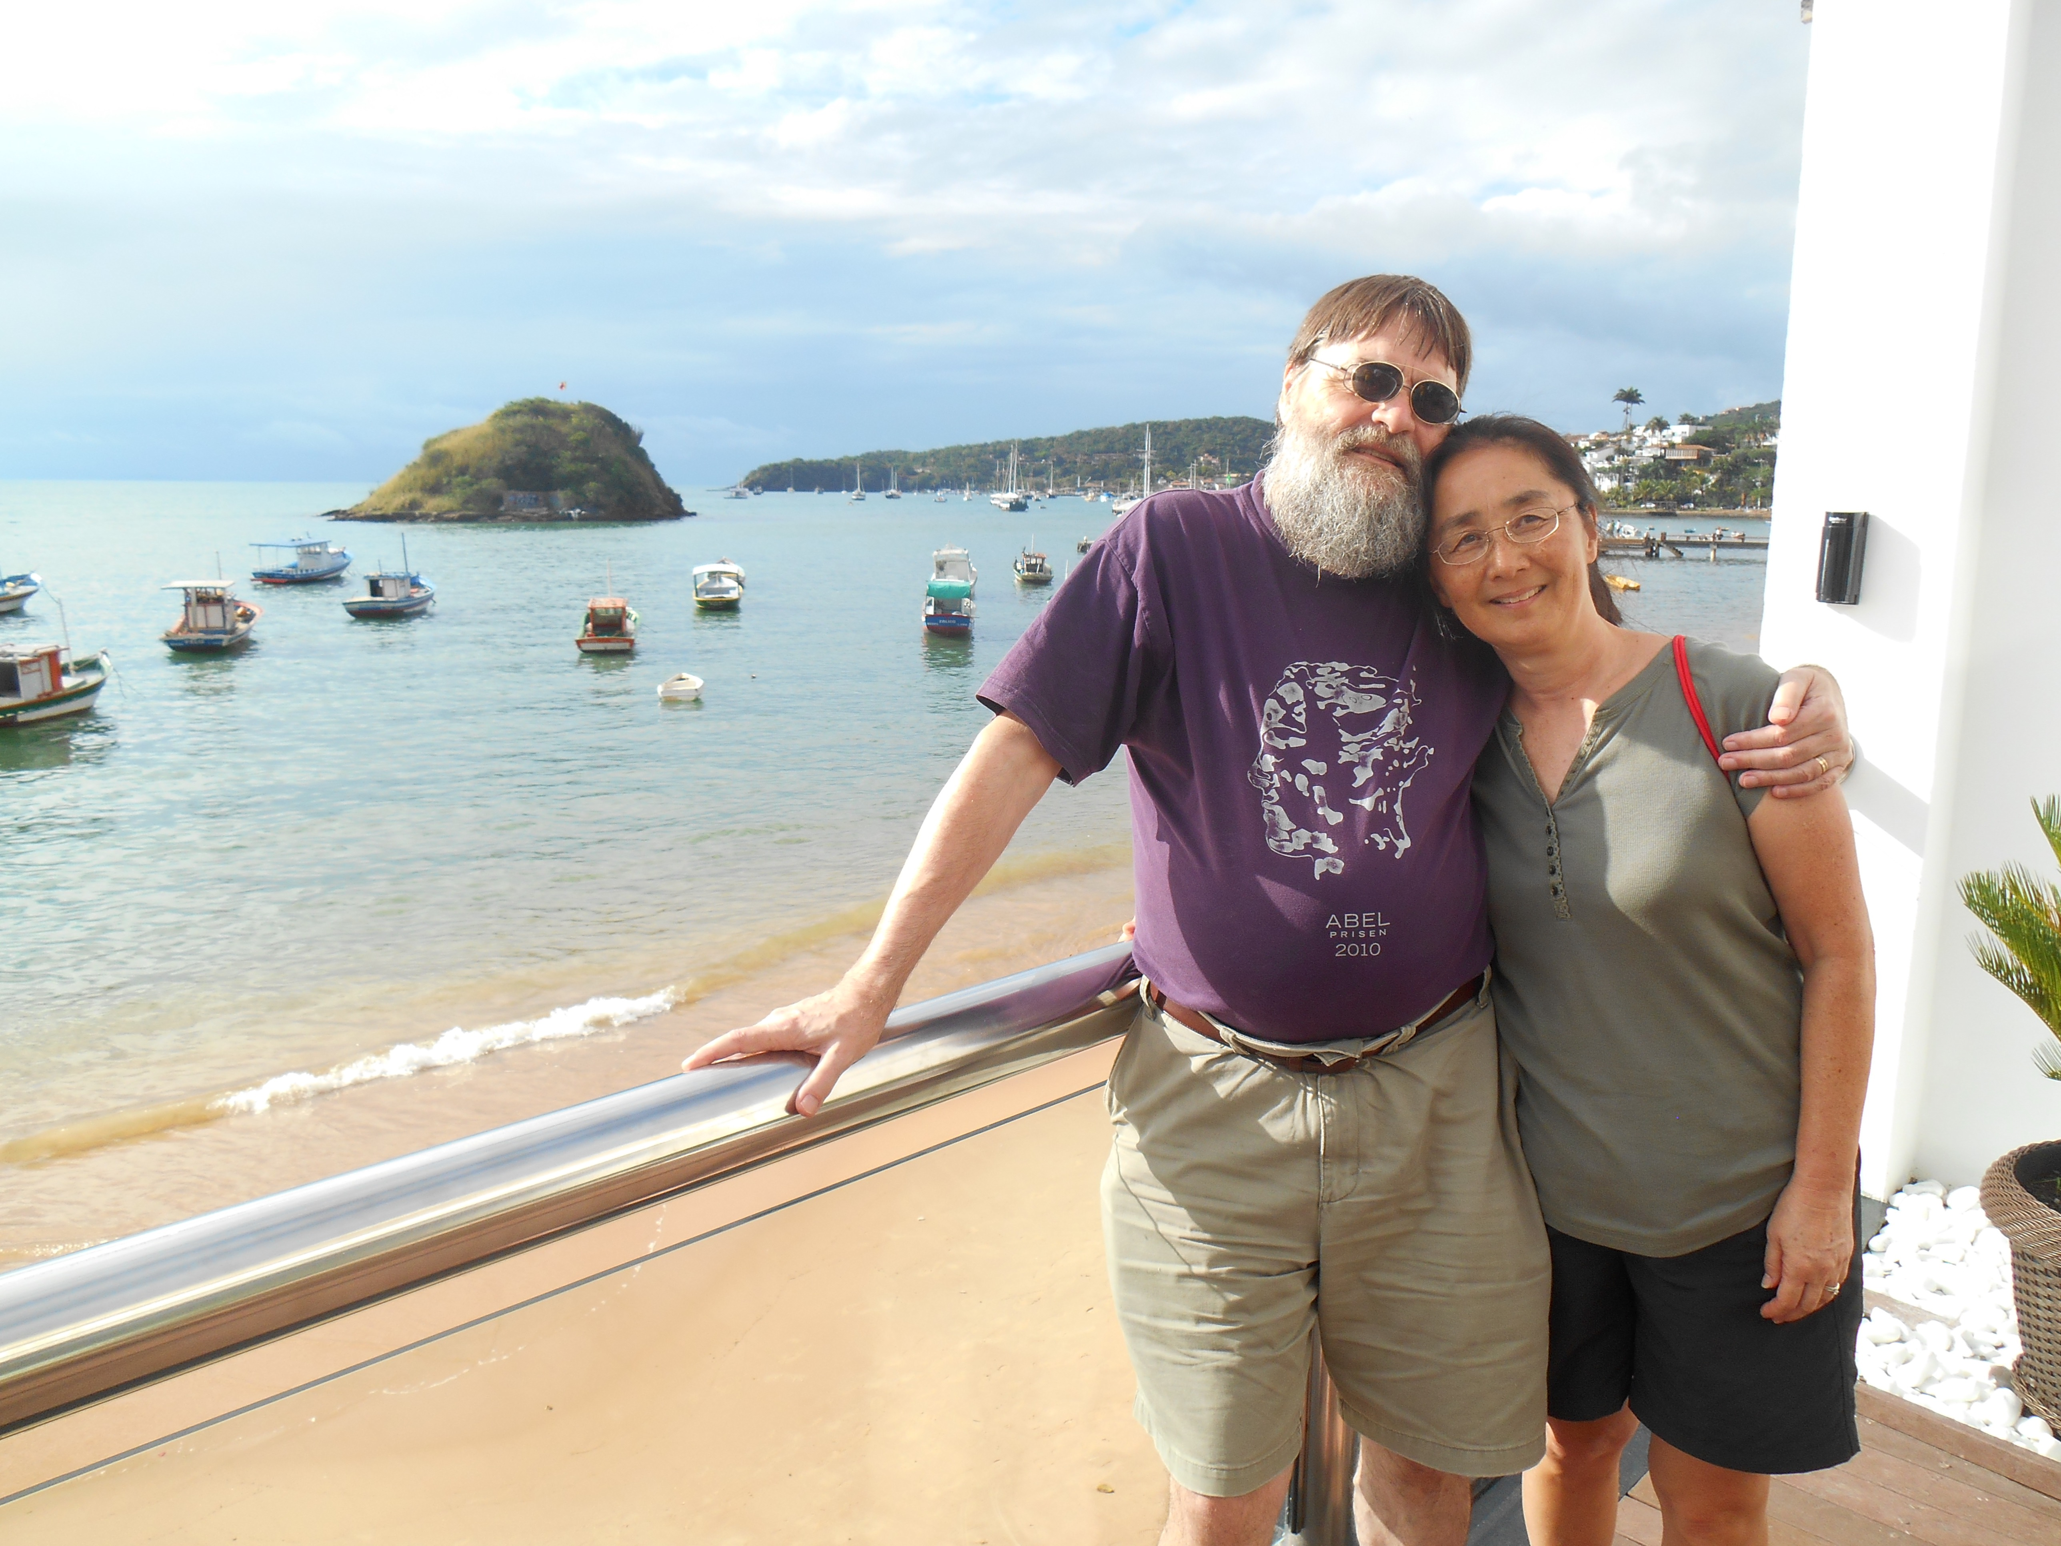

Slide 35
Notes:
Two more photos to wrap up. I just had to post this one.

Slide 36
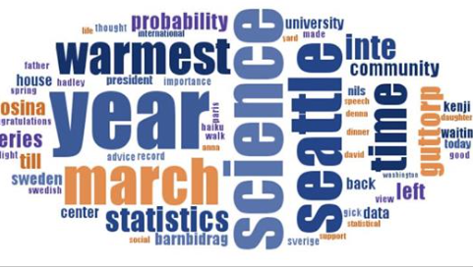
And final words from Peter
Notes:
Peter’s most used FB words.

Slide 37
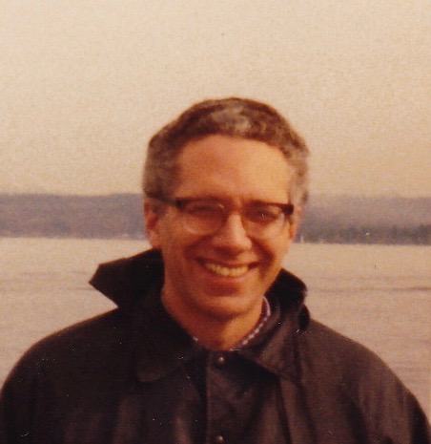
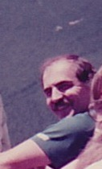
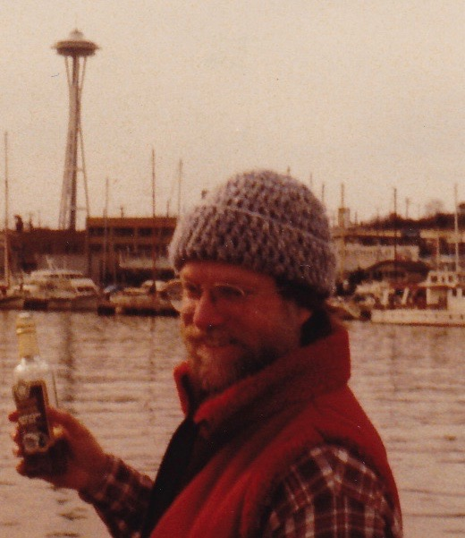
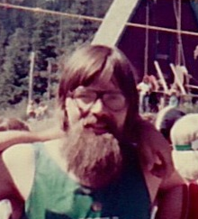
Thanks to the guys who brought me here in 1981
Doug
Peter
Michael
Galen
and the late Ron Pike
Notes:
And finally a word of thanks from me. Peter was the first new hire to the Department of Statistics at the UW in 1980, and he was then a member of the group who brought me to Seattle a year later. We all have had colleagues who played major roles in our academic careers, and Peter has been as important as anyone in mine. There would not have been a “Sampson-Guttorp Deformation Method” if not for Peter (and the inspiring problem raised by Jim Zidek, another major influence on me). A couple of weeks ago at a retirement celebration for me, an old friend and colleague made up a song with the line that “my retirement was a joke because I was not a retiring bloke”. This applies all the more to Peter (and to Jim) and there is no better testament to this than this very workshop. Thank you Peter.

